Slide 1

For discussion
SHUSA RDA Walkthrough and linkage to IHC project
Date Created: April 2015
Private & Confidential
Santander Holdings USA

Slide 2
1. Risk Data Aggregation and Reporting Framework (RDA)
Background
As stated in the first paragraph of the Basel Committee on Banking Supervision paper on Risk Data Aggregation and Risk Reporting Framework (BCBS 239):
“One of the most significant lessons learned from the global financial crisis that began in 2007 was that banks’ information technology (IT) and data architectures were inadequate to support the broad management of financial risks.
Many banks lacked the ability to aggregate risk exposures and identify concentrations quickly and accurately at the bank group level, across business lines and between legal entities.
Some banks were unable to manage their risks properly because of weak risk data aggregation capabilities and risk reporting practices. This had severe consequences to the banks themselves and to the stability of the financial system as a whole.”

Slide 3
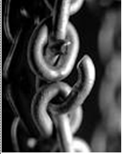
1. Risk Data Aggregation and Reporting Framework (RDA)
Background (cont’d)
BCBS 239 acknowledges that as a chain is a strong as its weakest link, risk reporting quality is as good as the weakest step in its life cycle.
BCBS 239 presents a set of 11 best practices (the “RDA” principles), to strengthen each individual step in the risk reporting life cycle, and in particular around risk data governance.
The Principles are expected to support a bank’s efforts to:
• Enhance the risk data aggregation and reporting infrastructure including reports to enable the board, senior management and risk managers to better identify, monitor and manage risks
• Improve the decision-making process throughout the banking organization
• Enhance the management of information at both the individual entities and consolidated level
• Reduce the probability and severity of losses resulting from risk management weaknesses
• Improve the timely delivery of information and resulting decision making capability
• Improve the organization strategic planning and its ability to manage the risk of new products and services.

Slide 4
1. Risk Data Aggregation and Reporting Framework
Summary of RDA principles
1
2
3
4
Governance
Independent Validation
Board accountability
Data Governance
Data Aggregation
Limitation awareness
Assessment at all levels
Data Architecture & IT Infrastructure
BCP & Impact analysis
Data Taxonomies
Data Ownership
Data Life Cycle
Data Quality Checks
Data Accuracy & Integrity
Accounting data standards
Manual Processes Controls
Data Dictionary
Data Reconciliation
Escalation Methodology
Completeness
Identify all Risk Factors
Document Aggregation Methodology
Exception management
Data Correction Process
5
6
7
Timeliness
Documented timeliness requirements
Timely report delivery in both normal and stressed situations
Adaptability
Ability to quickly adapt to change while maintaining data quality
Flexible data environment
Flexible data aggregation
Customizable reporting
Reporting Accuracy
Documented Accuracy Requirements
Documented Processes
Data Reconciliation
Reasonableness Checks
Integrated Data Quality controls
Comprehensiveness
Complete coverage of all risk factors
Forward looking Risk Assessment
Emerging Concentration risks
8
9
11
Legend:
Clarity & Usefulness
Clear and concise reports
Reports adapted to audience
Balance between qualitative and quantitative
Board Reporting
Executive reporting
Frequency
Report frequency adapted to audience
Ability to generate intraday and ad hoc reporting
Data Security
Data security
Entitlement policy
Documented distribution procedure
10
Governance/Infrastructure
Data Quality/CDO
Risk Reporting/MIS
Data Security/IT

Slide 5
2. Enhanced Prudential Standards (EPS)
Background
The EPS rule establishes a number of enhanced prudential standards for both Banking Holding Companies (BHCs) and Foreign Banking Organizations (FBOs). The latter will be required to establish a U.S. intermediate holding company (IHC) over their U.S. subsidiaries.
Additional focus on liquidity, risk management, and capital to increase the resiliency of companies’ operations and requirements of robust oversight over all US operations of a bank, highlighting the importance of having a global risk-management framework commensurate with its structure, risk profile, complexity, activities, and size, including⁽¹⁾:
Policies and procedures establishing risk-management governance, risk-management procedures, and risk-control infrastructure for its global operations; and
Processes and systems for implementing and monitoring compliance with such policies and procedures to identify and report risks and risk-management deficiencies, including emerging risks, and ensuring effective and timely implementation of actions to address emerging risks and risk-management deficiencies for its global operations
(1) As stated on section § 252.33 of the rule.

Slide 6

2. Combining RDA and EPS
Putting the pieces together (CART)
RDA is a ultimately a Group concern with EBA.
In the US the tool that local regulators can use to express their assessment of RDA compliance is CCAR.
In other words, RDA is a means to the end goal of passing CCAR on qualitative grounds with respect to MIS deficiencies and governance and to meet the desired risk-control infrastructure for the Intermediate Holding Company under Enhanced Prudential Standards.

Slide 7
3. RDA / IHC Initiatives – Status & Next Steps
RDA & EPS (IHC) Regulations
Both RDA and EPS (IHC)⁽¹⁾ regulations present a challenge for the US entities as they are required to significantly enhance risk management and decision-making processes based on strong risk data aggregation capabilities and robust internal risk reporting practices
Regulation
Benefits
Principles for effective risk data aggregation and risk reporting, BCBS 239
Strengthening the risk oversight, management and control⁽²⁾
Developing risk awareness and reach of Senior Management
Consistency: regulatory and management reporting, across business lines, Risk types (credit, market, op, etc) and functions (Risk, Finance/ Accounting), supporting passing CCAR on qualitative grounds.
Capital, liquidity and provisions optimization
Increasing efficiency and flexibility to generate recurrent and ad-hoc reports
RDA
11 principles with the aim of strengthening banks’ risk data aggregation capabilities and internal risk reporting practices
Enhanced Prudential Standards for BHC and FBO⁽¹⁾, 12 CFR Part 252
Keys for success
Alignment of RDA and IHC requirements to be able to define a consistent and integrated coverage strategy (Risk Architecture and T&O –systems-)
Involvement and accountability of all stakeholders: local (Units), SHUSA and the corporation
Activation of a robust data governance model, including an efficient escalation process, to monitor degree of advance, avoid bottlenecks, etc.
EPS / IHC
Focus on liquidity, risk management, capital and risk-control infrastructure for its global operations to increase the resiliency of companies’ operations and requirements of robust oversight over all US operations of a bank
SHUSA Risk MI is leading the production and implementation of an integrated plan to comply with the risk data architecture and IT infrastructure required for compliance with RDA and IHC requirements
The EPS rule establishes a number of enhanced prudential standards for both Banking Holding Companies (BHCs) and Foreign Banking Organizations (FBOs). The latter will be required, under certain circumstances, to establish a U.S. intermediate holding company (IHC) over their U.S. subsidiaries.
Both SHUSA and US Operations.

Slide 8
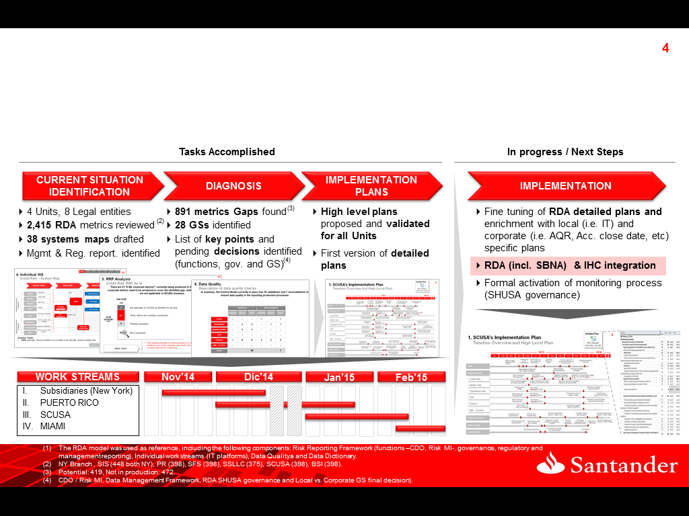
3. RDA / IHC Initiatives – Status & Next Steps
RDA initiatives
An RDA Discovery project involving Santander US entities (SCUSA, NY, Miami and PR) engaged Risk, Finance and T&O areas to analyze the degree of compliance with RDA/RRF requirements⁽¹⁾. Specific implementation plans per entity are being created to ensure RDA/RRF compliance by the end of 2015.
The RDA model was used as reference, including the following components: Risk Reporting Framework (functions –CDO, Risk MI-, governance, regulatory and management reporting), Individual work streams (IT platforms), Data Qualitya and Data Dictionary.
NY Branch , SIS (448 both NY), PR (398), SFS (398), SSLLC (375), SCUSA (398), BSI (398).
Potential: 419, Not in production: 472.
CDO / Risk MI, Data Management Framework, RDA SHUSA governance and Local vs. Corporate GS final decision).

Slide 9
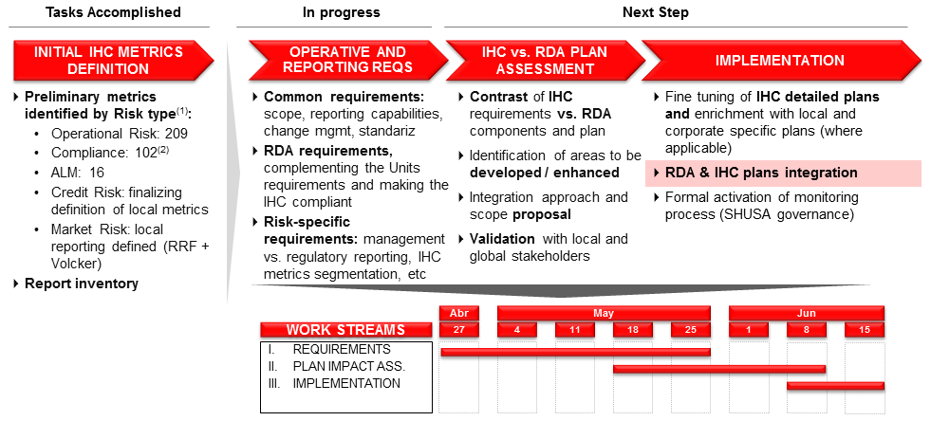
3. RDA / IHC Initiatives – Status & Next Steps
IHC initiatives
SHUSA Local RRF project is defining the operative and reporting model that will make the IHC compliant with this new regulation. Progress in this definition is key to understand the risk architecture implications thus defining an efficient and integrated IT architecture strategy
This preliminary identification of metrics needs to be evolved through prioritization, segmenting, identification of applicability across legal entities, etc.
Does not include Conduct risk.

Slide 10

Supporting RDA / IHC Documentation

Slide 11
A1. SHUSA RDA Governance Model
Centralized model, coordinating the efforts between Risk, Finance and T&O
Strong data governance framework, risk data architecture and IT infrastructure are required to enhance banks’ ability to identify and manager bank-wide risks (Basel, EPS, CCAR).
Proposed RDA Governance Model:
Centralized data governance at the IHC level, setting the tone at the top and synchronizing data enhancement efforts across the organization between Risk, Finance/Accounting and T&O
Risk Management Committees:
BERC, ERMC and Risk Data Aggregation and Risk Reporting Steering Committee as a sub-Committee of the ERMC
T&O Data Management Committees are responsible for the enterprise-wide coordination, implementation and governance of Data risk.

Slide 12
A1. SHUSA RDA Governance Model
Proposed Risk Management Committees
SHUSA BERC
SHUSA ERMC
The ERMC is a management committee established under the authority of the BERC. It is chaired by the SHUSA CRO and is responsible for the oversight and monitoring of all risk-taking and risk management activities across SHUSA, including oversight of Risk Data.
The BERC is established by and reports to the Board to support the Board in its oversight responsibilities with respect to all risk-taking and risk management activities and compliance matters. With regards to Risk Data its responsibilities include:
Monitor and oversee SHUSA’s and its Subsidiaries´ data governance, policies and status of data quality for the risk domains;
Review and oversee the capability of SHUSA’s infrastructure to fulfill the data architecture requirements needed to comply with RDA, CCAR, EPS and other regulations;
Review and escalate to the Board the potential risks that the limitation of IT infrastructure can have on data, the status of key projects and initiatives related to Data Governance, Data Architecture, and Data Quality improvement.
Review on an ongoing basis, and approve no less frequently than annually, the SHUSA Enterprise Risk Data Framework ensuring that it remains appropriate in light of regulatory requirements and SHUSA’s and its Subsidiaries strategic goals;
With regards to Risk Data, its responsibilities include the following:
Support the BERC in the discharge of its responsibilities, by reviewing all relevant documentation and management information before submission, and advising BERC on the status of Risk Data;
Receiving relevant information on Risk Data from the Risk Data Aggregation and Risk Reporting Steering Group.

Slide 13
A1. SHUSA RDA Governance Model
Proposed Risk Management Committees
SHUSA Risk Data Aggregation and Reporting Steering Committee
The Steering Group is a management committee established under the authority of the ERMC. It is chaired by the SHUSA CRO and is responsible for the Enterprise-wide SHUSA Risk Data Aggregation (“RDA”) project to ensure that its objectives are met in a manner appropriate to SHUSA, its Subsidiaries and the Santander Group. Its responsibilities are described in its charter and include, but are not limited to:
Reviewing and recommending for approval the Risk Data Framework, the Risk Data Dictionary and the Risk Reporting Framework;
Reviewing and approving before submission to Santander Group, the monthly reporting pack;
Reviewing and approving new or existing risk data requirements for local, regulatory or Santander Group reporting;
Coordinating the strategy of risk data projects across SHUSA and its Subsidiaries, including those that impact CCAR, Risk ID, Data Warehousing and Data Marts;
Reviewing the progress of the RDA project, assessing benefits and approving data remediation programs;
Deciding on the information to be escalated to ERMC, BERC or Board;
Making decisions on the best use of resources (including budget, staffing, IT development);
Reviewing matters escalated from the Risk Data Forum or the Data Governance Council by the Risk Data Owners;
Reviewing progress reports from the Risk Data Forum;
Supporting Risk Data Owners in the performance of their obligations under this RDARRF.
The Steering Group will coordinate and direct working groups as required and in coordination with the Data Governance Steering Group described below.

Slide 14
A2. SHUSA Local Risk Reporting Framework
Working in progress Local RRF for SHUSA / IHC, leveraging on SBNA’s
Risk Area |  | Corporate Metrics |  | Local Reports |  |  | Local Metrics
 |  |  |  | SHUSA | SBNA |  | SHUSA | SBNA
Credit Risk |  | 117 |  | 7 | 62 |  | 67 | 216
Operational Risk |  | 76 |  | 11 | 12 |  | 209 | 207
Trading/Market Risk |  | 92 |  | 71 |  |  | 137
ALM/Market Risk |  | 90 |  | 49 |  |  | 9
Compliance |  | 312 |  | 2 |  |  | 135
Other Non-Prudential Risks |  | 7 |  | 7 | 17 |  | 7 | 12
ERM |  | 694 |  | 5 | 8 |  | 273 | 119
Breakdown by Audience:
Reports
Metrics
Senior Management
53
247
Management
161
338
Regulatory
77
333
TOTAL
249
864
NOTES:
1) “Senior Management” criteria: Board and Level 1 Management Committees as per SHUSA ERM Framework.
2) Some of the reports and metrics are distributed to more than one audience.
PRELIMINARY INFORMATION UNDER REVIEW

Slide 15
A3. RDA Discovery Executive Summary
Corporate Metrics Gap Analysis per Unit and RDA area
Most relevant gaps in AML/Conduct and, to a lesser extent, Credit Risk and P/L estimates’ related metrics in ALM . A significant number of metrics are not currently in production but could potentially be produced if required
NY Branch & SIS
BSPR
SCUSA
BSI
Credit Risk
13 | 28 | 24 | 3
0 | 7 | 9 | -
0 | 0 | 23 | 11
0 | 15 | 19 | 8
10 | 22 | 46 | 17
54
14
36
43
Market Risk
5
4
4
Operational Risk
8
20
6
3
ALM
8
1
3
13
AML/
Conduct Risk
26
30
0
44
Metrics not in production, but that can potentially be produced if required

Slide 16
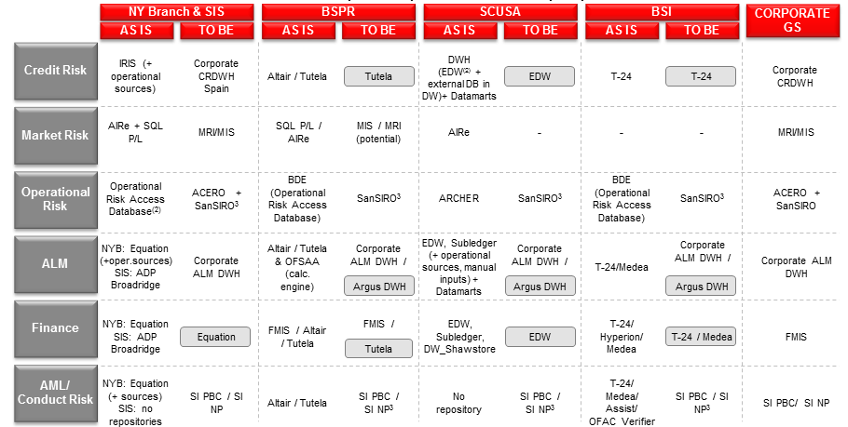
A3. RDA Discovery Executive Summary
Golden Sources Analysis per RDA area
Corporate GS deployment for Market Risk, Operational, AML & Conduct. Decision pending on ALM (DWH ALM vs Argus)- Architecture certification pending for some local solutions: Tutela (P. Rico), EDW (SCUSA) and T-24/Medea (BSI)
Current data repositories or Golden Source, if any identified
Portfolios serviced by SCUSA are currently included in EDW. Those portfolios serviced by others are included within the Data Warehouse structure but not in the EDW model
Use of San SIRO and SI PBC/NP for reporting to the corporation. For local exploitation possibility of using other local solutions (BDE, Archer,…)
Non-corporate Golden Sources require Architecture certification

